Slide 1
Advanced persistent threats (APT)

Slide 2
Overview:
An advanced persistent threat (APT) is a sophisticated computer network threat actor, primarily a nation-state or state-sponsored group, that gets illegal access to a network and remains undetected for an extended period. APT may also refer to non-state-sponsored groups carrying out large-scale targeted attacks for specific purposes.
APT techniques - The APT employs persistent, secretive, and sophisticated hacking techniques to access a system and remain inside it for extended periods, potentially causing damage.
Targets - APTs are typically directed at high-value targets, such as nation-states and large corporations, due to the level of effort required to carry out these attacks.
Sponsor - In most cases, APT groups are involved with state-sponsored threat actors.

Slide 3
identifications
Country | Symbols
Russia | Bear
Vietnam | Buffalo
North Korea | Chol lima
Iran | Kitten
Pakistan | Leopard
China | Panda
USA | Owl

Slide 4

Apt34
Origin: Iran
Active since at least 2014
Animal: Cat
Also known as Helix, FireEye, and OILRIG
Primary Targets: This group has broadly targeted various industries, including financial, government, energy, chemical, and telecommunications, and has largely focused its operations in the Middle East.
Main Weapon: APT34 reportedly uses Microsoft Excel macros, PowerShell-based exploits and social engineering to gain access to its targets.
In April 2019, APT34's cyber-espionage tools' source code was leaked through Telegram.

Slide 5
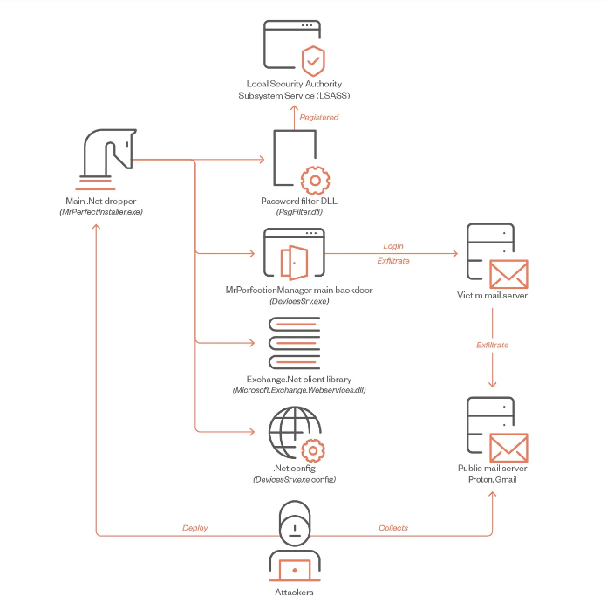
Latest news: https://www.trendmicro.com/en_us/research/23/b/new-apt34-malware-targets-the-middle-east.html

Slide 6
Thank you

